Slide 1
Use Case Analysis
Systems analysis and design, 6th edition
Dennis, wixom, and roth

Slide 2
Learning Objectives
Explain the purpose of use cases in the analysis phase of the SDLC.
Describe the various parts of a use case and the purpose of each part.
Describe how use cases contribute to the functional requirements.
Describe how use cases inform the development of test plans.
Explain the process used to create a use case.

Slide 3
What is a Use Case?
Understanding the purpose of this tool

Slide 4
Role of Use Cases
Use cases express and clarify user requirements.
Purpose - define the expected interaction between user and system.
Use that interaction to more fully describe functional requirements
Used extensively in the analysis phase. Often a part of user interviews or JAD sessions.
Text-based use cases are easy for the users to understand.
Flow easily into the creation of process models and the data model.

Slide 5
Use Cases
Represents how a system interacts with its environment
Illustrates the activities that are performed by the users and the system’s responses.
Activities produce some output result.
Each use case describes how an external user triggers an event to which the system must respond.
In event-driven modeling, everything in the system can be thought of as a response to some triggering event.

Slide 6
Use Case Styles
Elements and formats

Slide 7
Elements of a Use Case
Each use case has a name and number, and brief description.
The priority may be assigned to indicate the relative significance.
The actor refers to a person, another system, or a hardware device that interacts with the system to achieve a useful goal.
The trigger for the use case – the event that causes the use case to begin.
Events triggers can be external or temporal

Slide 8
Definitions and Symbols
Use Case
Actor
Boundary
Connection
Include relationship
Extend relationship
<<include>>
<<extend>>

Slide 9
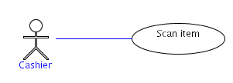
Association
The line between an actor and a use case is an association.
The association means the actor is participating and/or communicating with the system via that use case.
The meaning of the association can be refined with:
Multiplicity
Direction
Labels

Slide 10
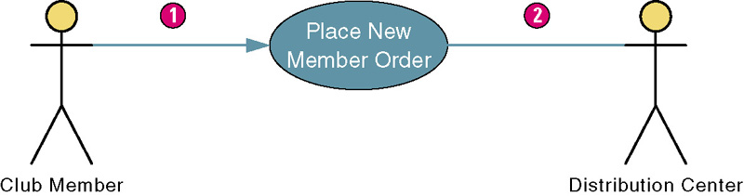
Use Case Association
Association – a relationship between an actor and a use case in which an interaction occurs between them.
Association modeled as a solid line connecting the actor and the use case.
Association with an arrowhead touching the use case indicates that the use case was initiated by the actor. (1)
Association lacking arrowhead indicates a receiver actor. (2)
Associations may be bidirectional or unidirectional.
Trigger
Receive Results
Notes:
Teaching Notes
Most of the use case diagrams in this chapter shown only the primary system actor. This one also shows the external receiver actor. Use cases can be drawn to show some or all actors.

Slide 11
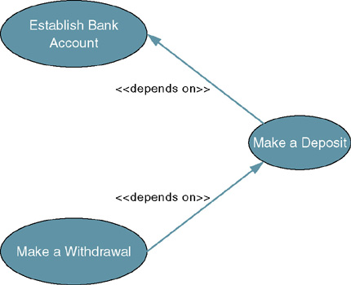
Depends On Relationship
Depends On – use case relationship that specifies which other use cases must be performed before the current use case.
Can help determine sequence in which use cases need to be developed.
Depicted as arrow beginning at one use case and pointing to use case it depends on.
Labeled <<depends on>>
Notes:
Teaching Notes
Identifying use case dependencies is discussed at the end of the chapter. It is useful when using build cycles to build the system in successive versions.

Slide 12

Inheritence of Actors
One actor can be a specialization of another.
Arrow points to the more general (base) actor.

Slide 13
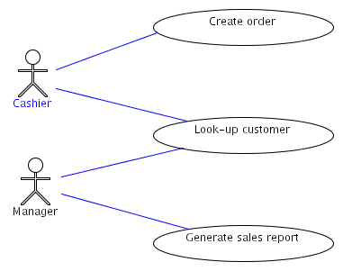
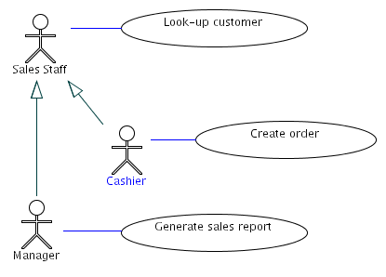
Using Generalization
Notes:
On the left, it looks like either a cashier or a manager may look up a customer, but from the use case point of view, both are not needed in the same interaction. On the right, the correction shows both roles are able to look-up customer because they are both specializations of the sales staff role. From the use case point of view, there is only one role interacting with looking up a customer.

Slide 14
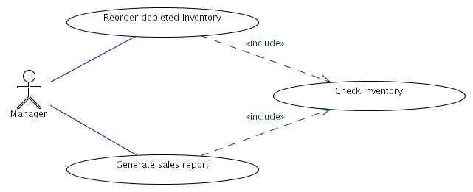
Includes
“Factor out” of a use case commonly used behavior
Allows reuse of functionality by multiple use cases

Slide 15
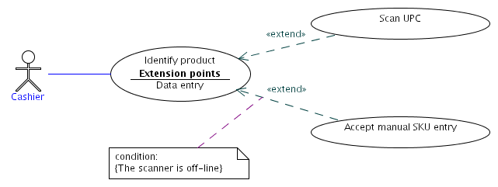
Extends
Indicates that one use case adds or replaces behavior of another
Must have a an associated extension point
May have a condition

Slide 16
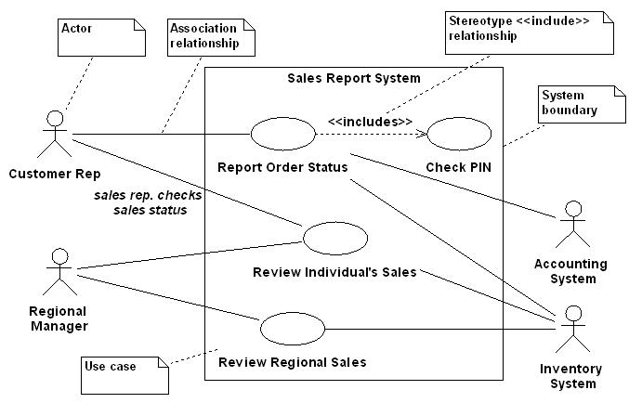
Example: A Sales Report System

Slide 17
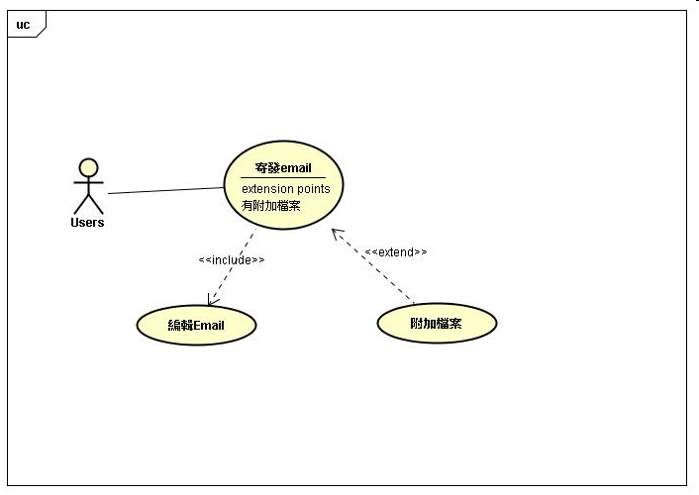
Example: Sending Email
Source: http://hsiangyuwang.blogspot.com/2009/03/umluse-case-diagramextendinclude.html

Slide 18
The Process of Requirements Use-Case Modeling
Steps
Identify business actors.
Identify business use cases.
Construct use-case model diagram.
Documents business requirements use-case narratives.
Notes:
Teaching Notes
The individual steps will be discussed on the following slides.

Slide 19
Step 1: identify Business Actors
When looking for actors, ask the following questions:
Who or what provides inputs to the system?
Who or what receives outputs from the system?
Are interfaces required to other systems?
Are there events that are automatically triggered at a predetermined time?
Who will maintain information in the system?
Actors should be named with a noun or noun phrase
Notes:
Teaching Notes
By focusing first on actors, you concentrate on how the the system will be used instead of how it will be built.
Focusing on actors helps refine and further define the scope and boundaries of the system.
Also, by first identifying actors you find candidates to interview and observe so you can develop and validate the use cases.

Slide 20
Step 2: Identify Business Requirements Use Cases
Business Requirements Use Case - a use case created during requirements analysis to capture the interactions between a user and the system free of technology and implementation details.
During requirements analysis, strive to identify and document only the most critical, complex, and important use cases, often called essential use cases.
Notes:
No additional notes.

Slide 21
Step 2: Identify Business Requirements Use Cases (cont.)
When looking for use cases, ask the following questions:
What are the main tasks of the actor?
What information does the actor need form the system?
What information does the actor provide to the system?
Does the system need to inform the actor of any changes or events that have occurred?
Does the actor need to inform the system of any changes or events that have occurred?
Use cases should be named with a verb phrase specifying the goal of the actor
Notes:
No additional notes.

Slide 22
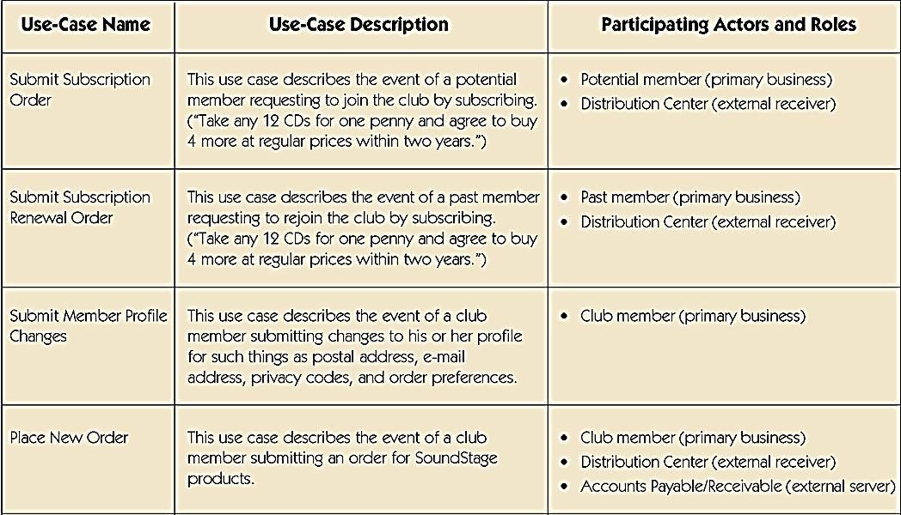
Sample Use-Case Glossary
Notes:
No additional notes

Slide 23
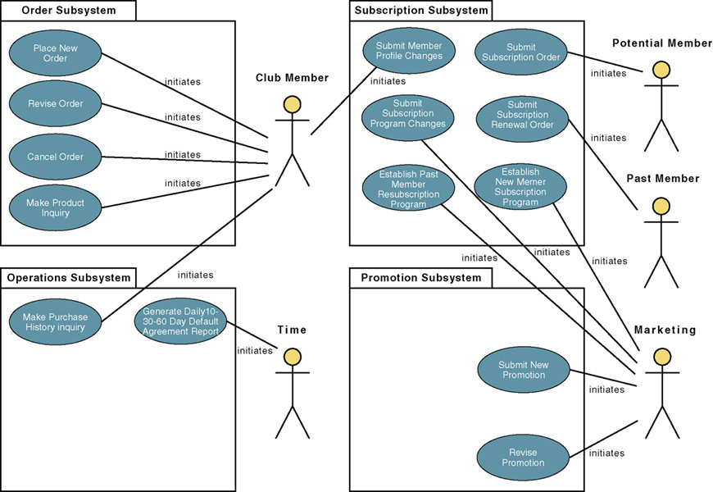
Step 3: Construct Use-Case Diagram
Notes:
Teaching Notes
Note that the use cases have been grouped into business sub-systems. This is key to defining your development strategy – which use cases will be developed first and by whom.

Slide 24
Step 4: Document Use-Case Scenarios
Document first at high level to quickly obtain an understanding of the events and magnitude of the system.
Then expand to a fully-documented business requirement narrative.
Include the use case’s typical course of events and its alternate courses.
Notes:
No additional notes.

Slide 25
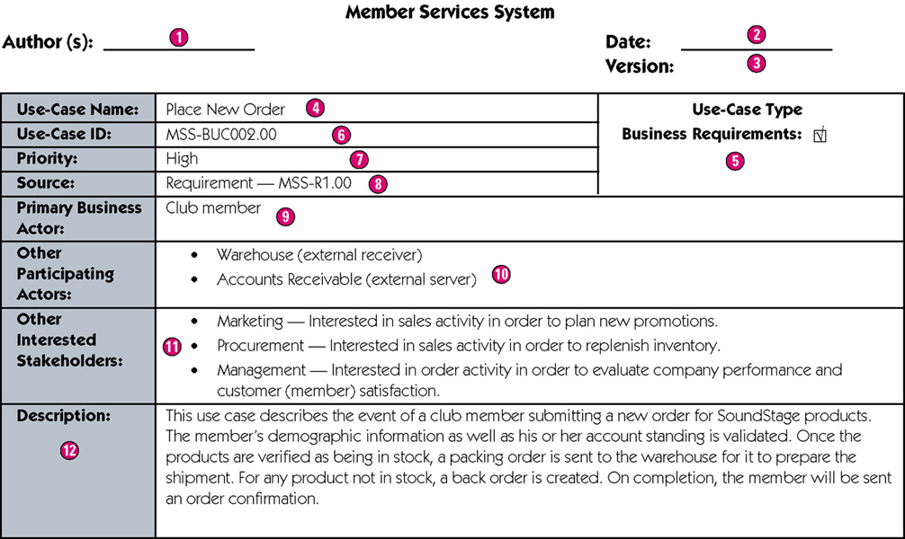
Sample High-Level Version of a Use-Case Scenario
Notes:
Teaching Notes
Author – the persons who wrote the use case and provide a point of contact for anyone requiring additional information.
Date – the date the use case was last modified.
Version – the current version of the use case.
Use-case name – the use-case name should represent the goal that the use case is trying to accomplish. Should begin with a verb.
Use-case type – Business requirements use cases provide a general understanding of the problem domain and scope but don’t include detail to communicate to developers what the system should do.
Use-case ID – A unique identifier for the use case.
Priority – The priority communicates the importance of the use case (high, medium, or low).
Source – The source defines the entity that triggered the creation of the use case.
Primary business actor – The stakeholder that primarily benefits from the execution of the use case.
Other participating actors – Other actors that participate in the use case.
Interested stakeholders – A person (other than the actor) who has a vested interest in the goal of the use case.
Description – A short summary description of the purpose of the use case and its activities.

Slide 26
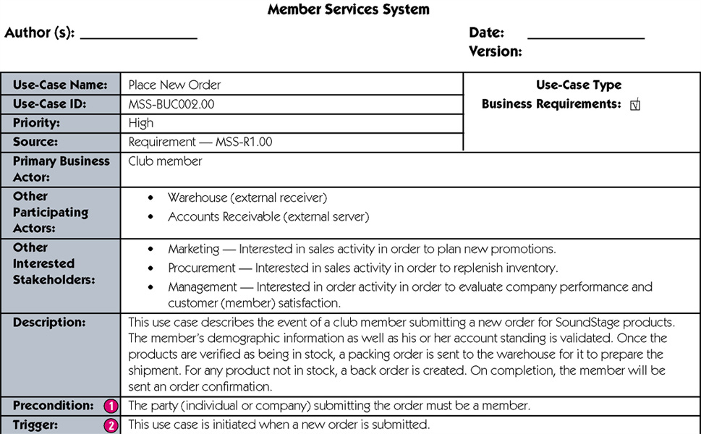
Expanded Version of a Use-Case Scenario
continued
Notes:
Teaching Notes
Precondition – A constraint on the state of the system before the use case can be executed.
Trigger – The event that initiates the use case.

Slide 27
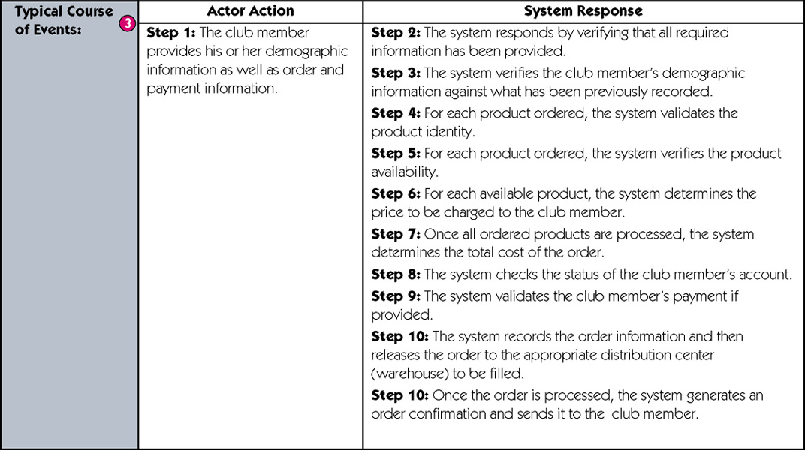
Expanded Version of a Use-Case Scenario
continued
Notes:
Teaching Notes
Typical course of events – The normal sequence of activities performed by the actor(s) and the system to satisfy the goal of the use case.

Slide 28
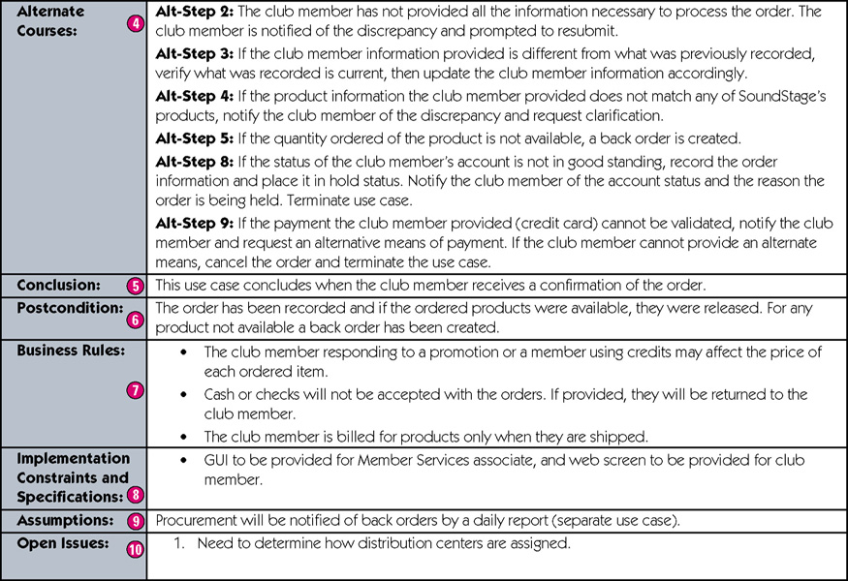
Sample Expanded Version of a Use-Case Narrative (cont)
concluded
Notes:
Teaching Notes
Alternate courses – The behaviors of the use case if an exception or variation to the typical course occurs.
Conclusion – When the use case successfully ends.
Postcondition – A constraint on the state of the system after the use case has successfully executed.
Business rules – Policies and procedures of the business that the system must abide by.
Implementation constraints and specifications – Any nonfunctional requirements that may impact the realization of the use case.
Assumptions – Assumptions made by the author.
Open issues – Issues that need to be resolved before the use case can be finalized.

Slide 29
In Class Exercise
請撰寫”線上論壇”的use cases
所有使用者皆可瀏覽與閱讀文章
已登入的使用者可以發表文章
文章作者跟站長可以刪除文章
請評估是否有地方適合使用 <<extend>> or <<include>>

Slide 30
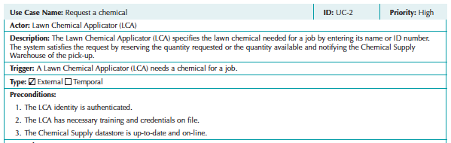
Use Case Basic Information
From Figure 4-1
Casual Format Use Case

Slide 31
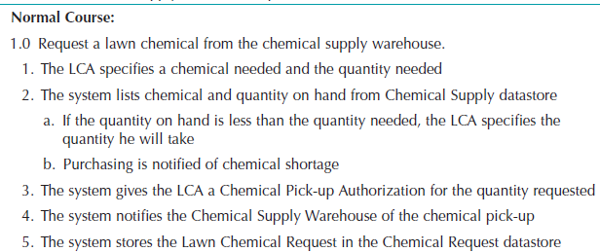
Normal Course
The major steps that are performed to execute the response to the event

Slide 32
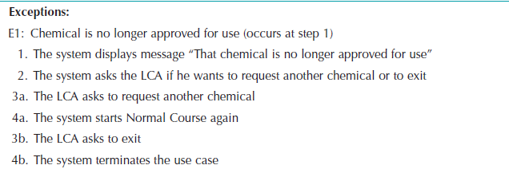
Exceptions
Error conditions encountered while performing use case steps.
NOT normal branches in decision logic.
Lead to an unsuccessful result.

Slide 33
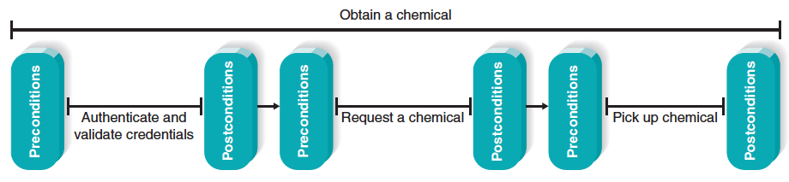
Use Cases in Sequence
Uses cases often performed in sequence.
No single use case should be too large.
Important to define initial and ending states.

Slide 34
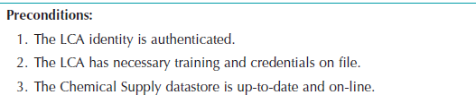
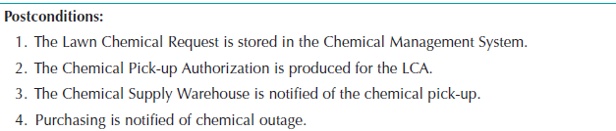
Preconditions and Postconditions
Preconditions define what must be complete before beginning this use case.
Postconditions define what is complete when this use case ends.

Slide 35
Fully-Dressed Use Case Format
Very thorough, detailed, and highly structured.
Adds new sections, including,
Alternative courses
Inputs and outputs for steps
Summary inputs and outputs.
See Figure 4-3 for example

Slide 36
Fully-Dressed Use Case Format, con’t.
Use this format when:
Users are not closely engaged with development team
Project has high complexity and high risk
Test cases need to be fully described
Remote collaborating teams need detailed, shared understanding of user needs.

Slide 37
Use Case Practical Tips
Use gradual refinement.
Concentrate on describing the user’s objectives with the system completely and accurately.
Keep both audiences in mind – users and developers.
Create use cases only when needed to clarify what the system must do from the user’s perspective. Not needed for simple events.

Slide 38
Use Cases and the Functional Requirements
Use cases are useful tools to clarify user requirements.
Use cases convey only the user’s point of view.
Transforming the user’s view into the developer’s view through functional requirements is one of the system analyst’s key contributions.
The derived functional requirements tell the developers more about what the system must do.

Slide 39
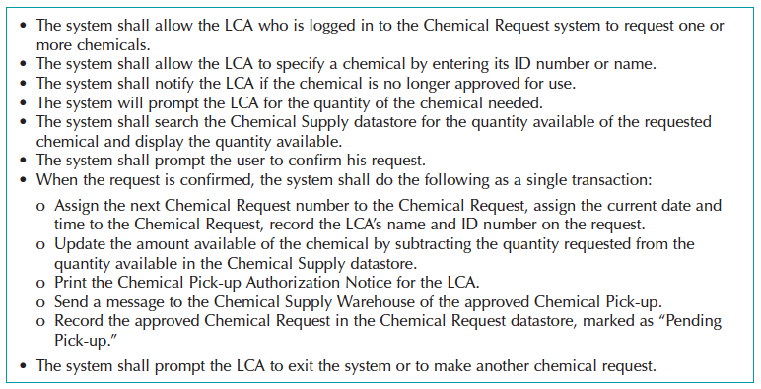
Detailed Functional Requirements
Use case content used to create more complete and descriptive functional requirements

Slide 40
Creating Use Cases
Identify events the system must respond to – develop Event-Response List
Create use case form for the complex events
For each use case:
Identify the major steps
Identify elements with each major step (inputs and outputs)
Confirm use case with users through role-playing
Revise functional requirements as needed

